Slide 1
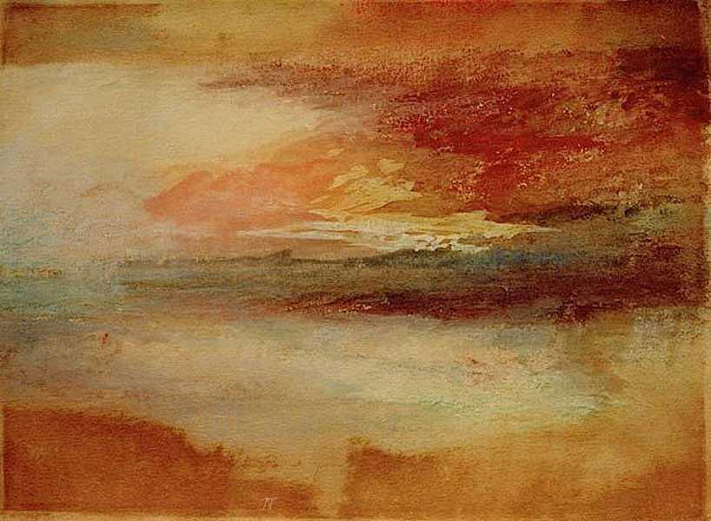
“Le Vent, le Cri”
Música
Compositor: Ennio Morricone
Π

Slide 2
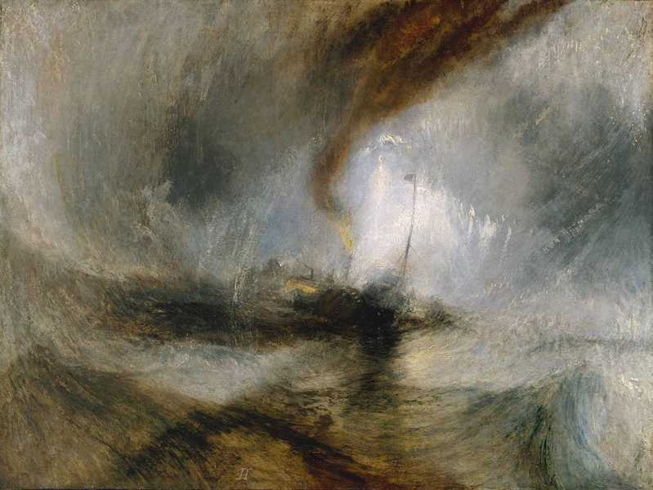
Turner

Slide 3
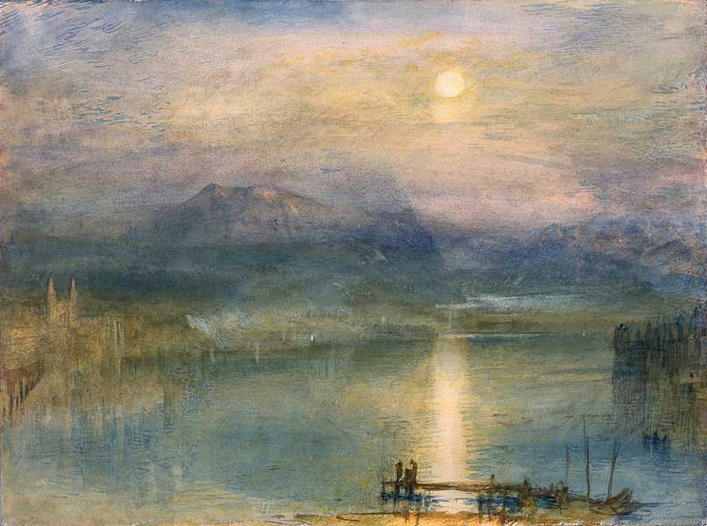
Turner

Slide 4
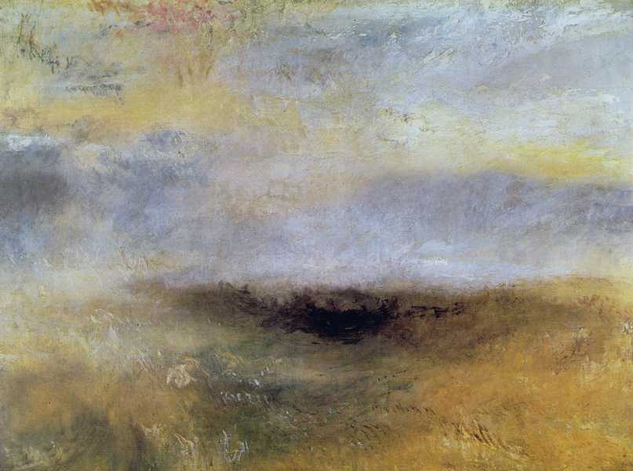
Turner

Slide 5
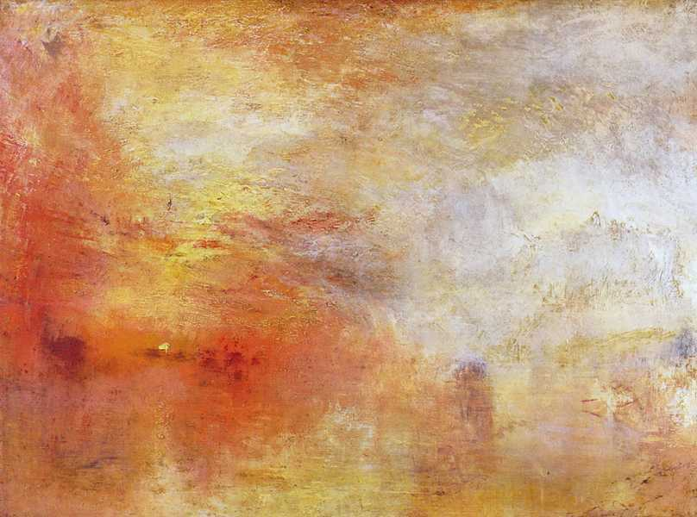
Turner

Slide 6
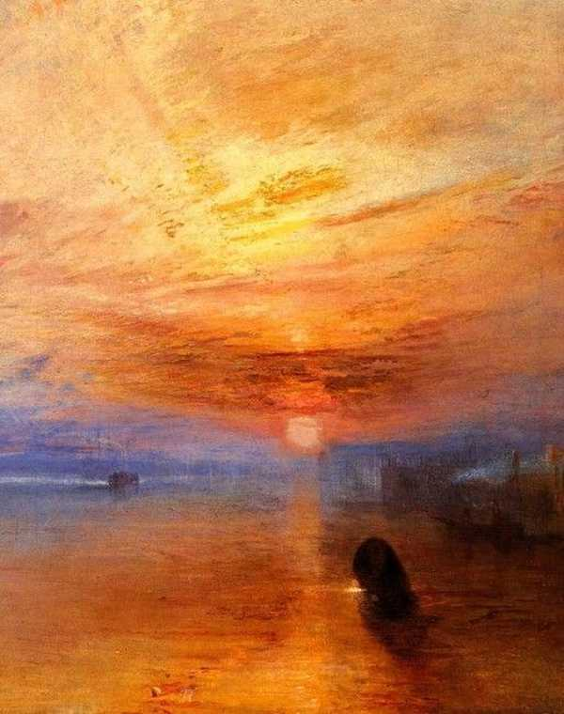
Turner

Slide 7
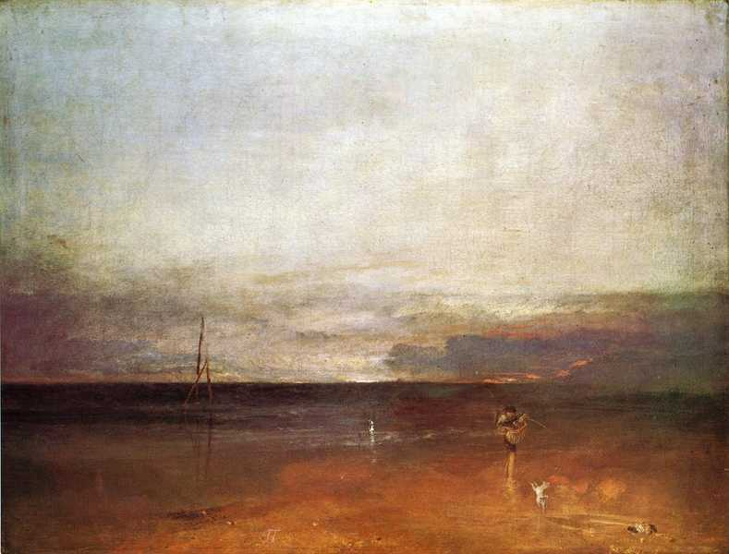
Turner

Slide 8
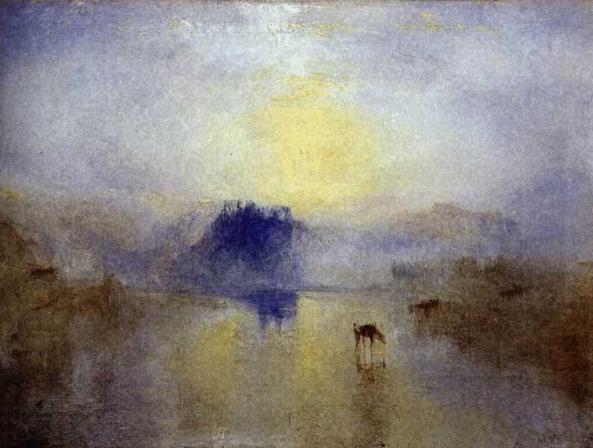
Turner

Slide 9
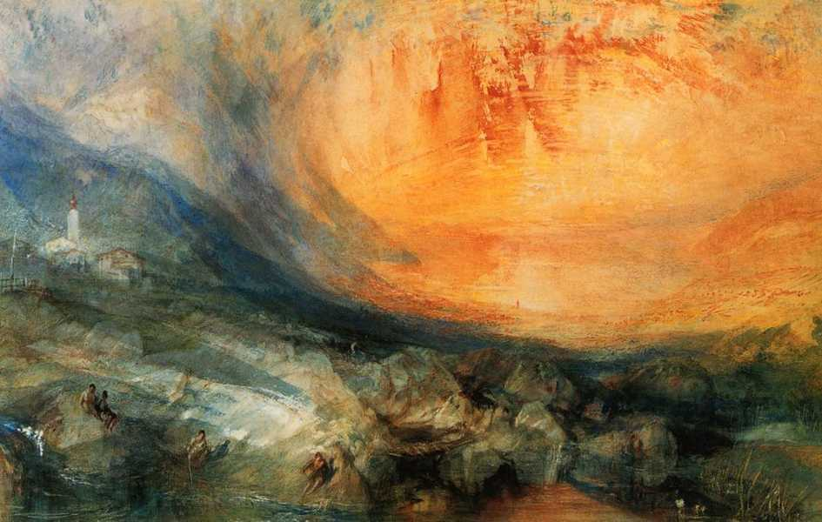
Turner

Slide 10
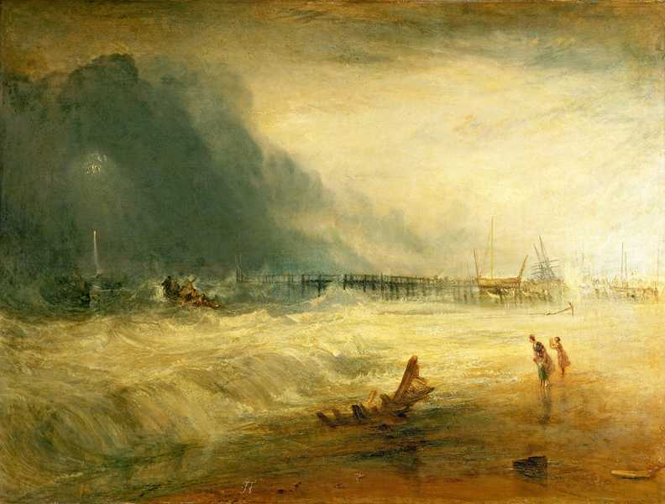
Turner

Slide 11

Turner

Slide 12
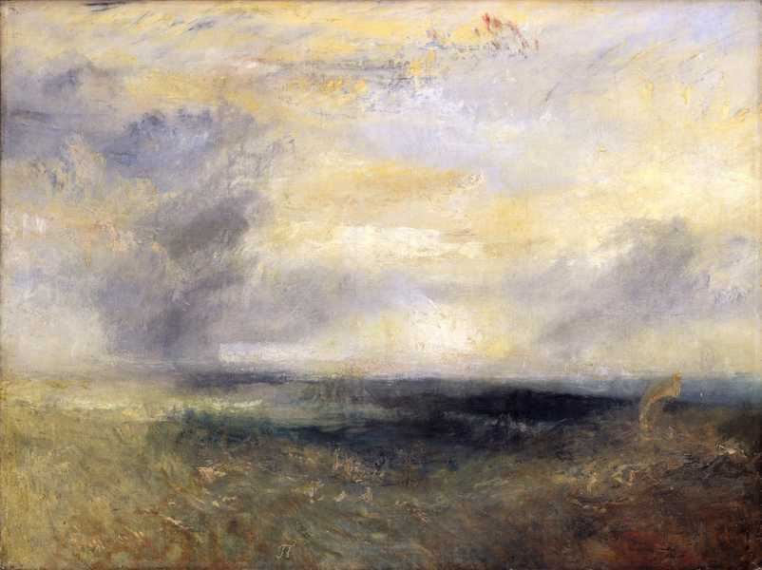
Turner

Slide 13
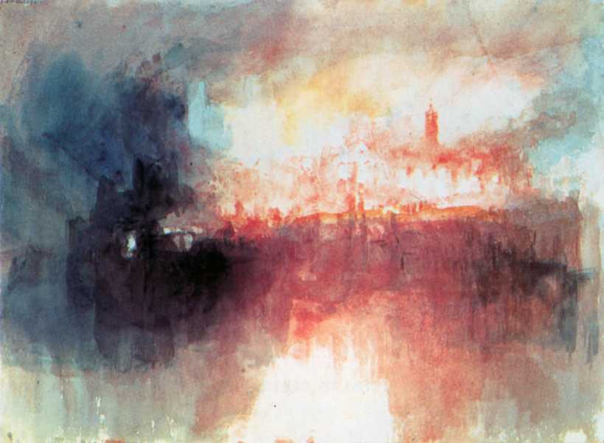
Turner

Slide 14
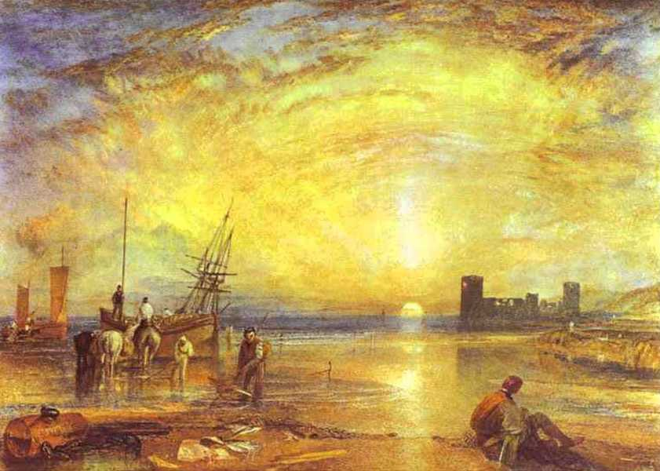
Turner

Slide 15
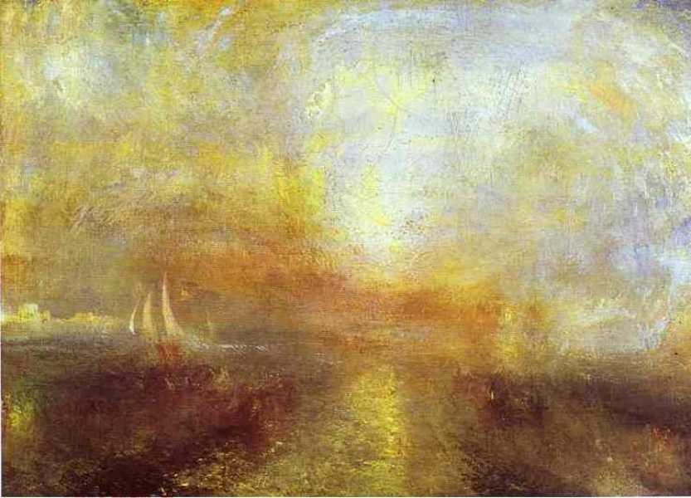
Turner

Slide 16
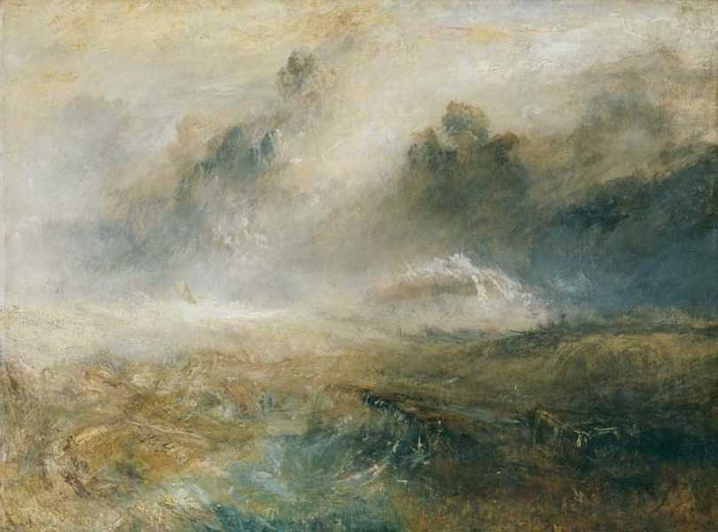
Turner

Slide 17
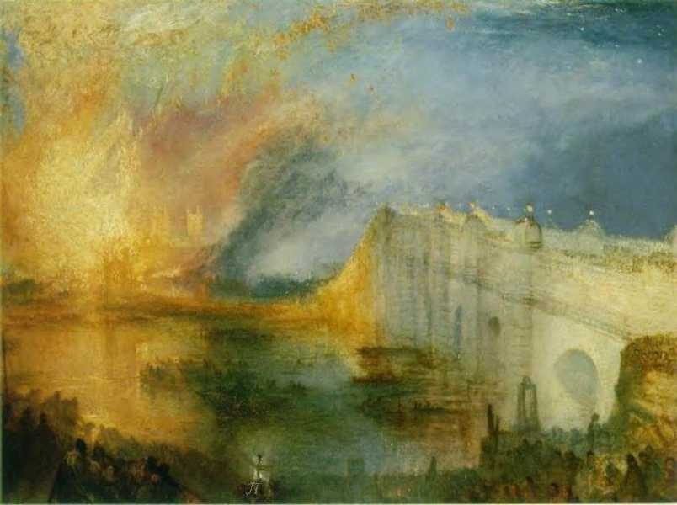
Turner

Slide 18
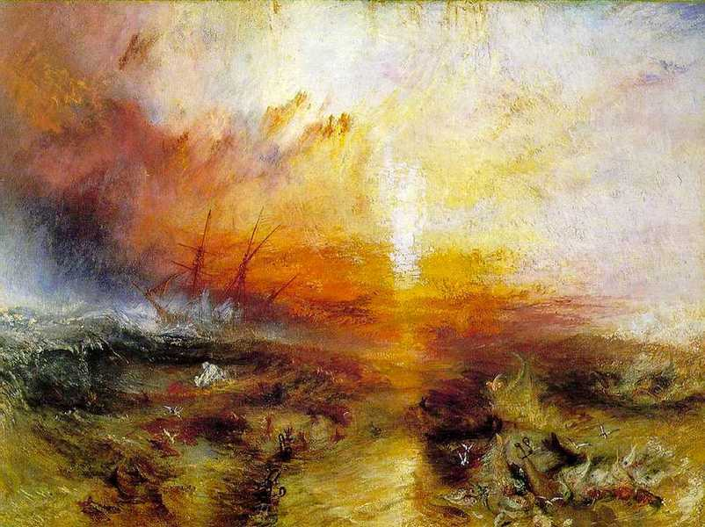
Turner

Slide 19
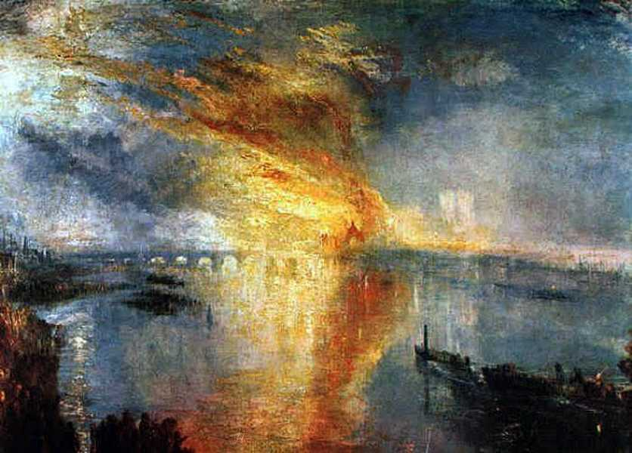
Turner

Slide 20
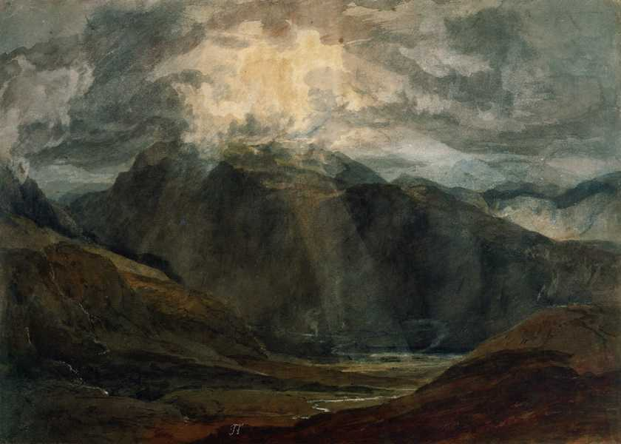
Turner

Slide 21
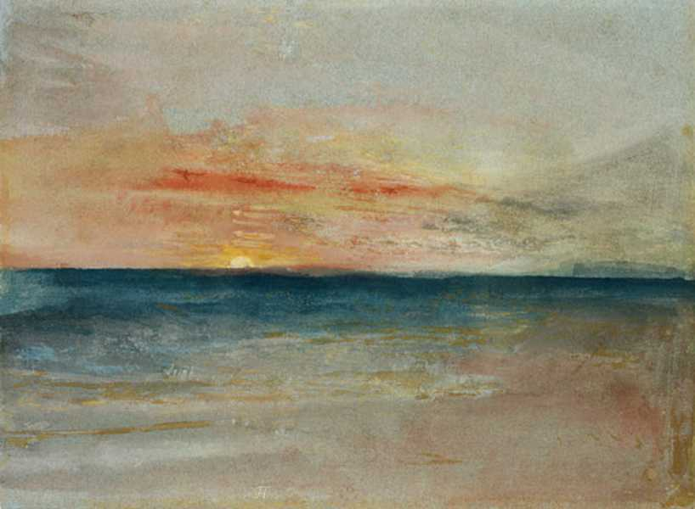
Turner

Slide 22
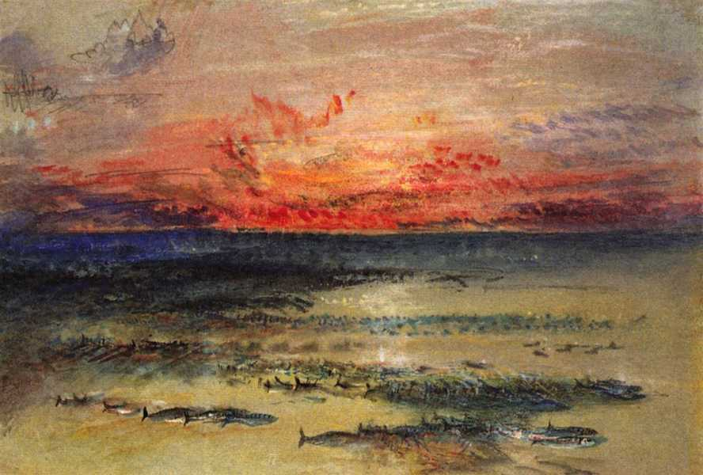
Turner

Slide 23
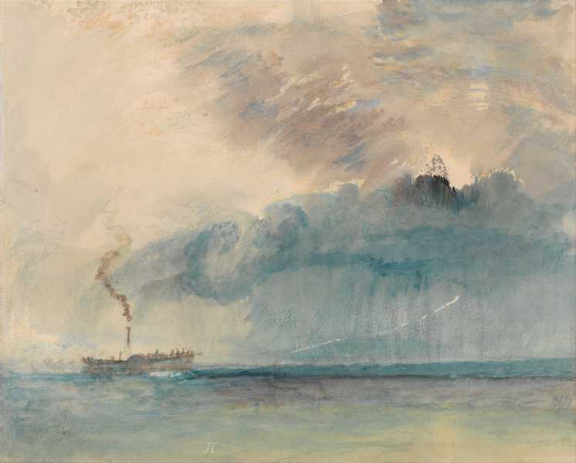
Turner

Slide 24
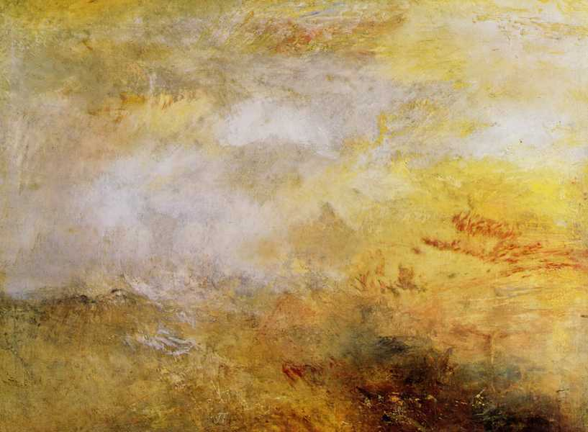
Turner

Slide 25
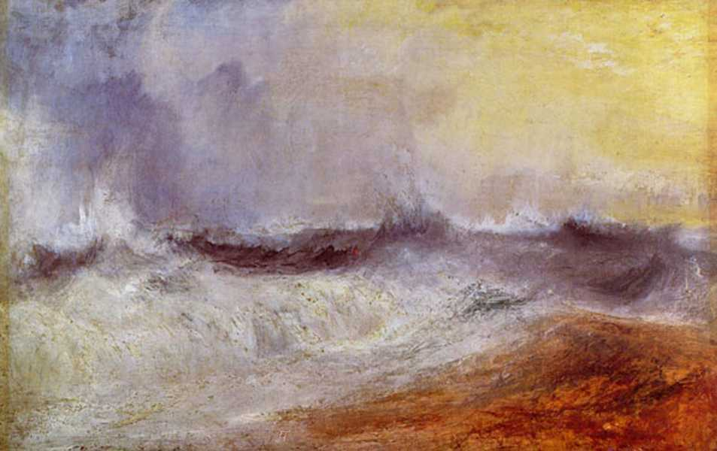
Turner

Slide 26
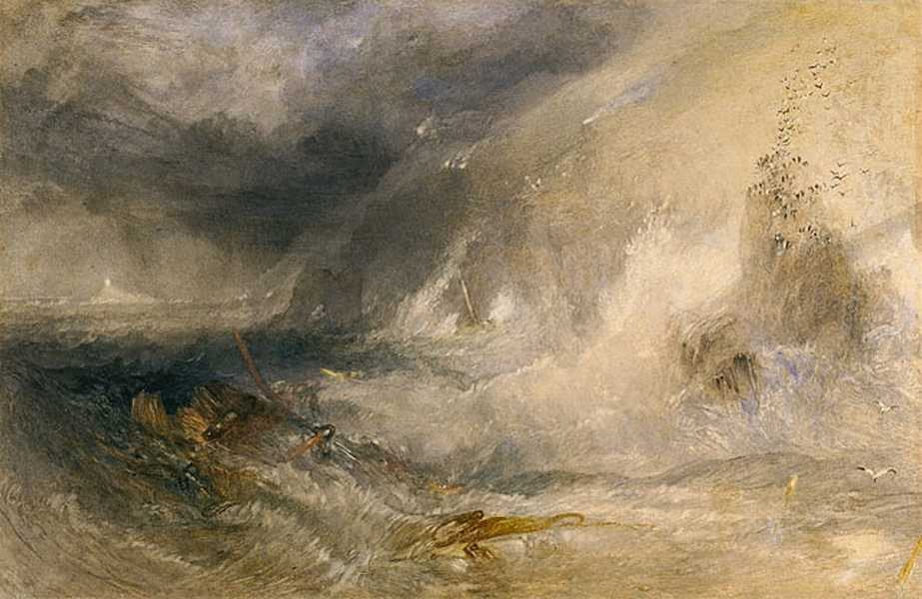
Turner

Slide 27

Turner

Slide 28
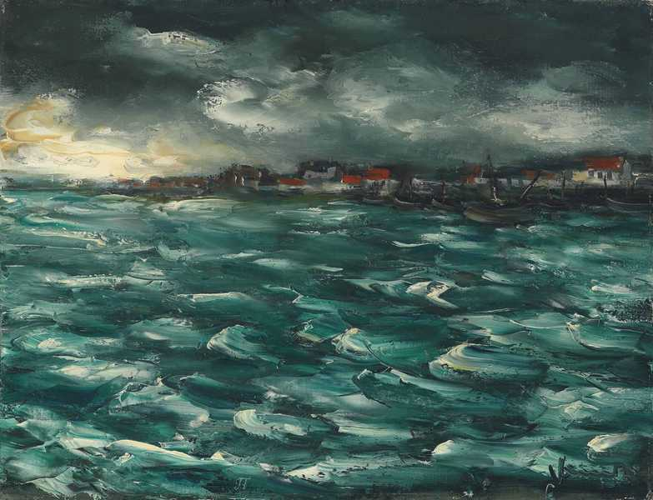
Vlaminck

Slide 29
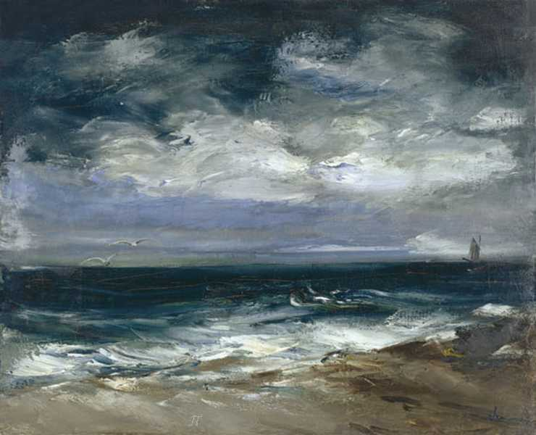
Vlaminck

Slide 30
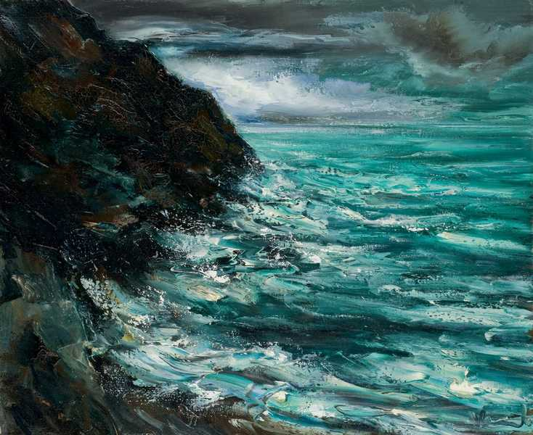
Vlaminck

Slide 31
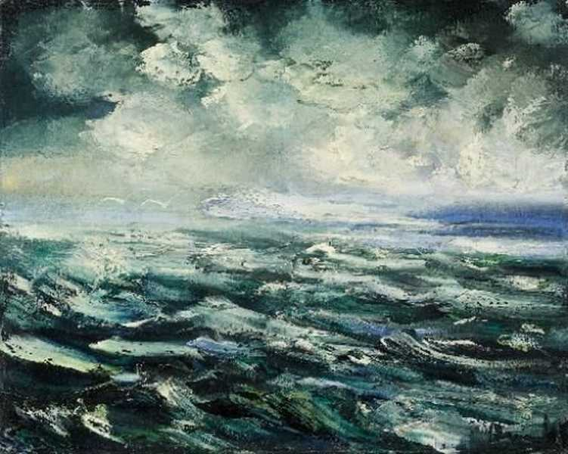
Vlaminck

Slide 32
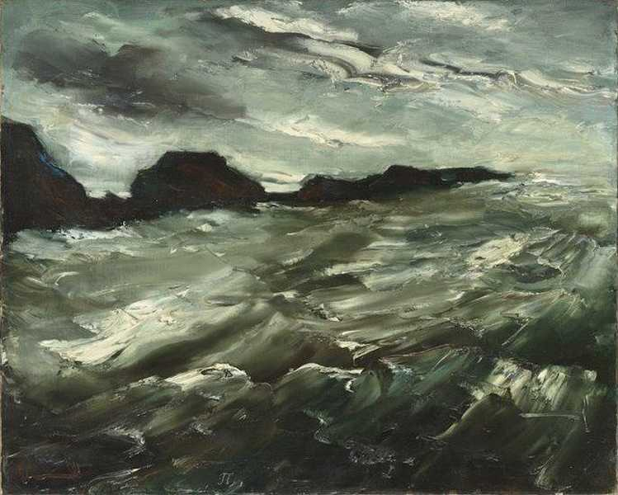
Vlaminck

Slide 33
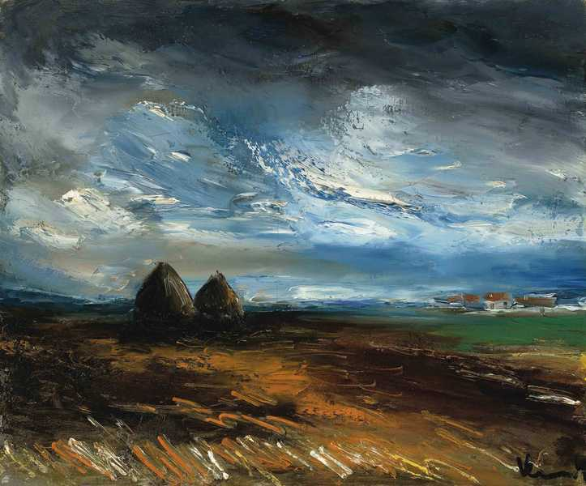
Vlaminck

Slide 34
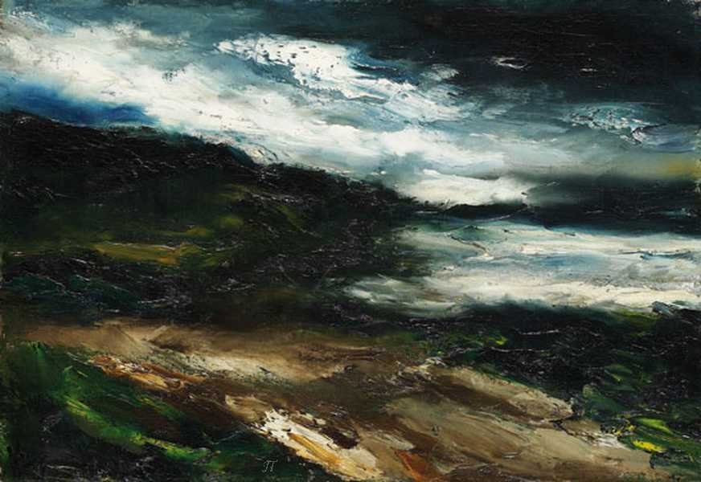
Vlaminck

Slide 35
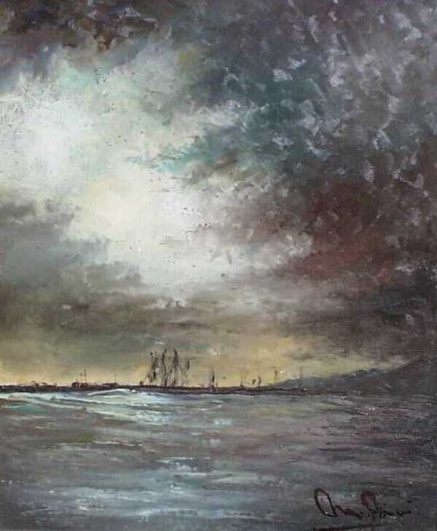
M. Moris

Slide 36
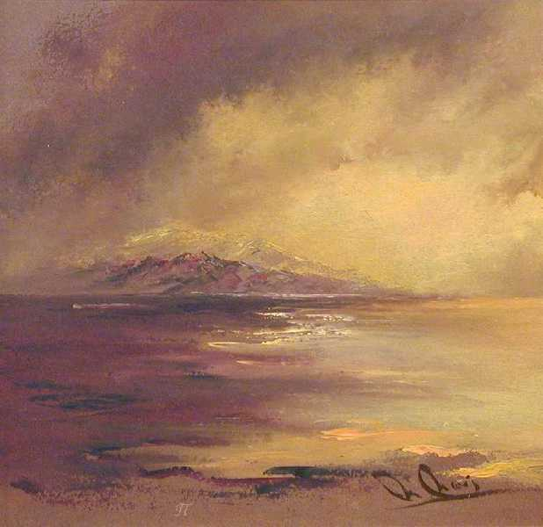
M. Moris

Slide 37

M. Moris

Slide 38
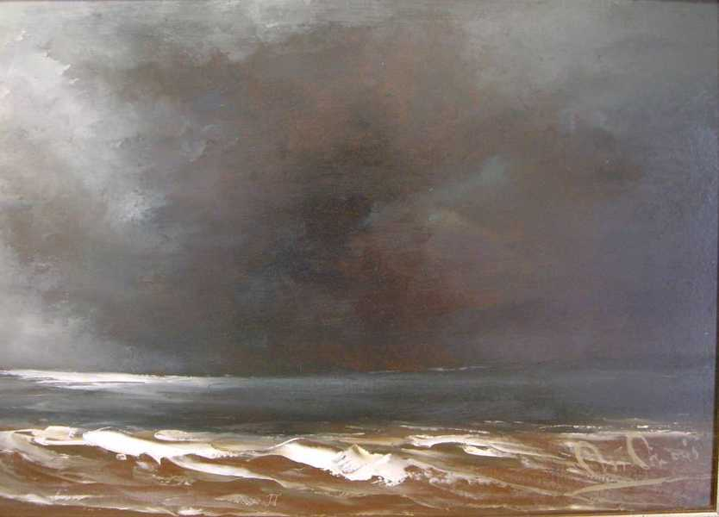
M. Moris

Slide 39
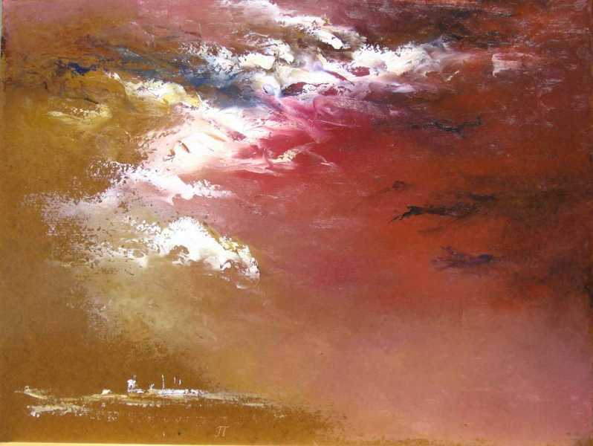
M. Moris

Slide 40

M. Moris

Slide 41
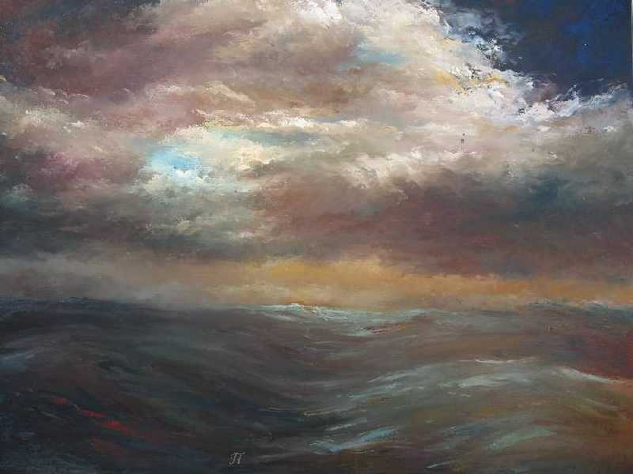
M. Moris

Slide 42
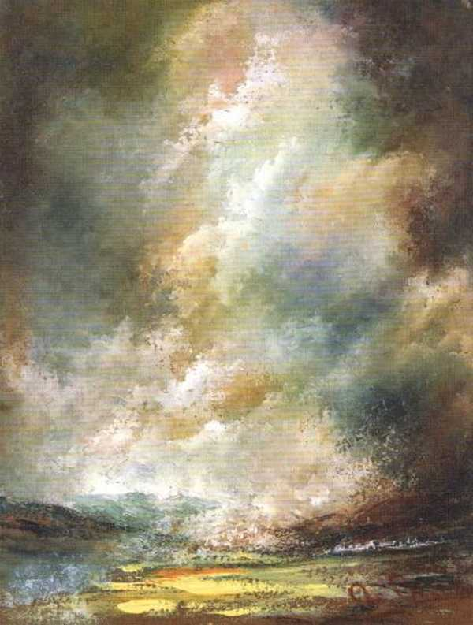
M. Moris

Slide 43
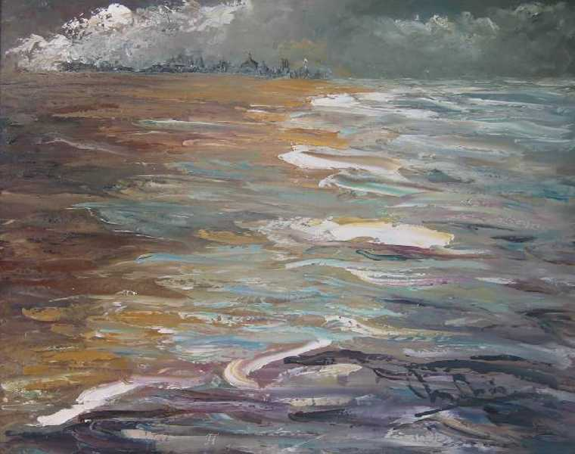
M. Moris

Slide 44

M. Moris

Slide 45
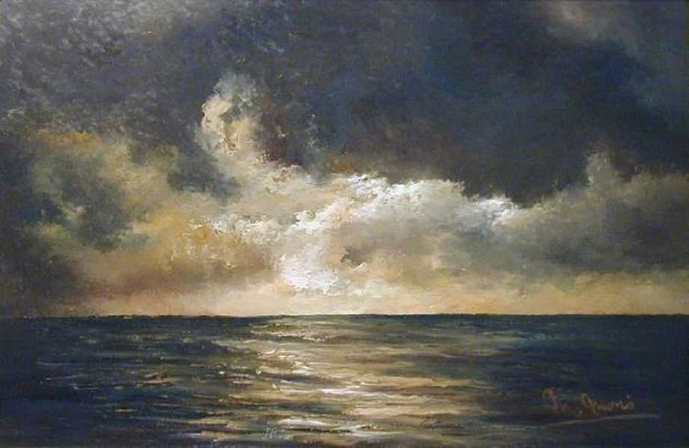
M. Moris

Slide 46
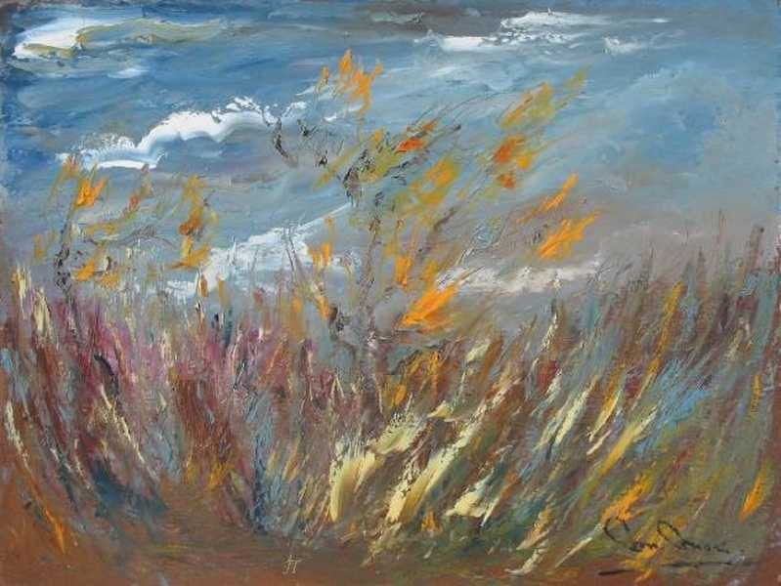
M. Moris

Slide 47
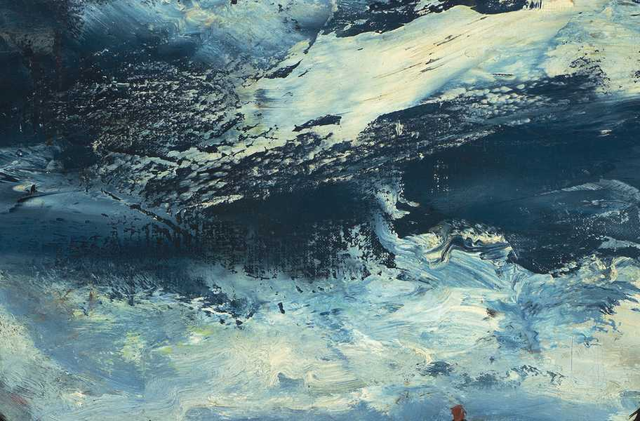

altapi1@gmail.com
Imágenes procedentes de Internet
Sin ánimo de lucro – Non profit
Π

